Slide 1

MKU BAHASA INGGRIS Universitas Siber Asia Sesi 2_INTRODUCTION
Team Teaching UNSIA

Slide 2
INTRODUCING YOURSELF
Hello, my name is…
Hey! I am ....
Hi! They call me …
Response
Nice to meet you, I am…
Pleased to meet you. I am …
Let me introduce my self. I am …
I’d like to introduce myself. I am ….

Slide 3
Giving more information
Age
I am 26 years old
I am 26
Place
I am from Bandung
I come from Jakarta
I live in Surabaya

Slide 4
Giving more information
Work
I am a lecturer
I am a student
I work as a dentist
I work in a Private Company

Slide 5
What do you like to do
I like reading books / watching movie/ playing guitar
I like cooking the dishes
I am good at playing badminton
I like to shop when I am free

Slide 6
Introducing Others
Jack, please meet Aisyah
Jack, have you meet Aisyah?
I’d like you to meet Joni
I’d like to introduce you to Bayu
Sarah, this is Bayu. Bayu this is Sarah

Slide 7
Useful responses when introducing yourself or others
Nice to meet you
Pleased to meet you
Happy to meet you
How do you do?

Slide 8
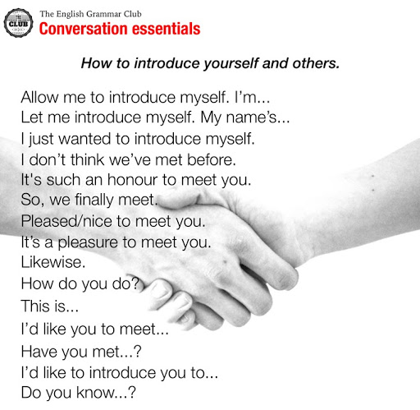

Slide 9
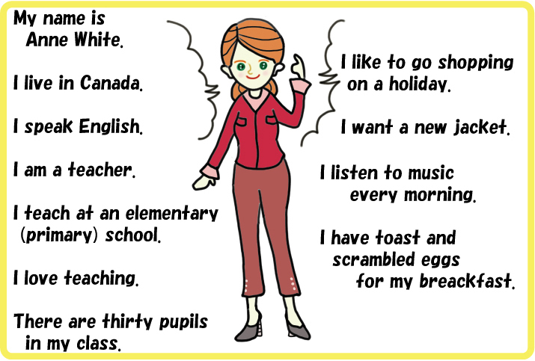

Slide 10
Thank You

